Slide 1
Health and Security of FOSS Supply Chain
Justin Chao
September 22, 2022

Slide 2
FOSS
Free and Open-Source Software
1. The freedom to run the program as you wish, for any purpose
2. The freedom to study how the program works and change it so it does your computing as you wish.
Access to the source code is a precondition for this.
3. The freedom to redistribute copies so you can help others.
4. The freedom to distribute copies of your modified versions to others.
By doing this you can give the whole community a chance to benefit from your changes.
Access to the source code is a precondition for this.
Notes:
In the 60s and 70s, computers were hardware focused and the hardware were expensive.
They were mainly used by academics in universities or researchers in labs.
The limited amount of software used to come for free or with their source code and the users were allowed to modify the source code to suit their need.
In the late 70s and early 80s, the manufacturer’s stopped distributing source code in an attempt to not let their software run on their competitor’s computers.
This restrictive licensing led to the inconvenience and dislike of people who were used to and fond of modifying software.
In the mid 80s, Richard Stallman started the Free Software Movement.
GNU project — Stallman launched the GNU Project in September 1983

Slide 3

FLOSS
Free and Libre Open-Source Software

Slide 4
Global Supply & Demand for FOSS

Slide 5
Global Supply & Demand for FOSS
The Economics of FOSS
80-90% of any given modern application is comprised of open source software.
Heavy reliance on FOSS is common in both the public and private sectors, tech and non-tech companies alike.
Ensuring the health and security of FOSS Supply Chain is critical to the future of nearly all industries in the modern economy.
Notes:
Understand what components are being used, and how well they are being maintained and supported.

Slide 6
Global Supply & Demand for FOSS
Software Supply Chain
Notes:
Traditional manufacturing-based supply chains have trusted suppliers who build components used in the final assembly of the finished product.
Traditional supply chains have also streamlined logistics and sourcing by using large, centralized warehouses to store and distribute those components with more security and efficiency.
Toyota has a limited set of trusted suppliers in their supply chain.
They know exactly where their parts are coming from, who created them, and what cars they are going into.
Because of that knowledge, they can trace any defects or safety issues that arise back to the source.
Understanding what components are used, where, and how they are being used is difficult because…

Slide 7
Global Supply & Demand for FOSS
Economics of FOSS
Today’s development ecosystem is very complicated because of the amount of components out there.
Most if not all components have transitive dependencies.
Number of OSS projects coming to market every day is sharply increasing each year.
Notes:
1,096 new projects per day
10,000 new versions per day
14x releases per year

Slide 8
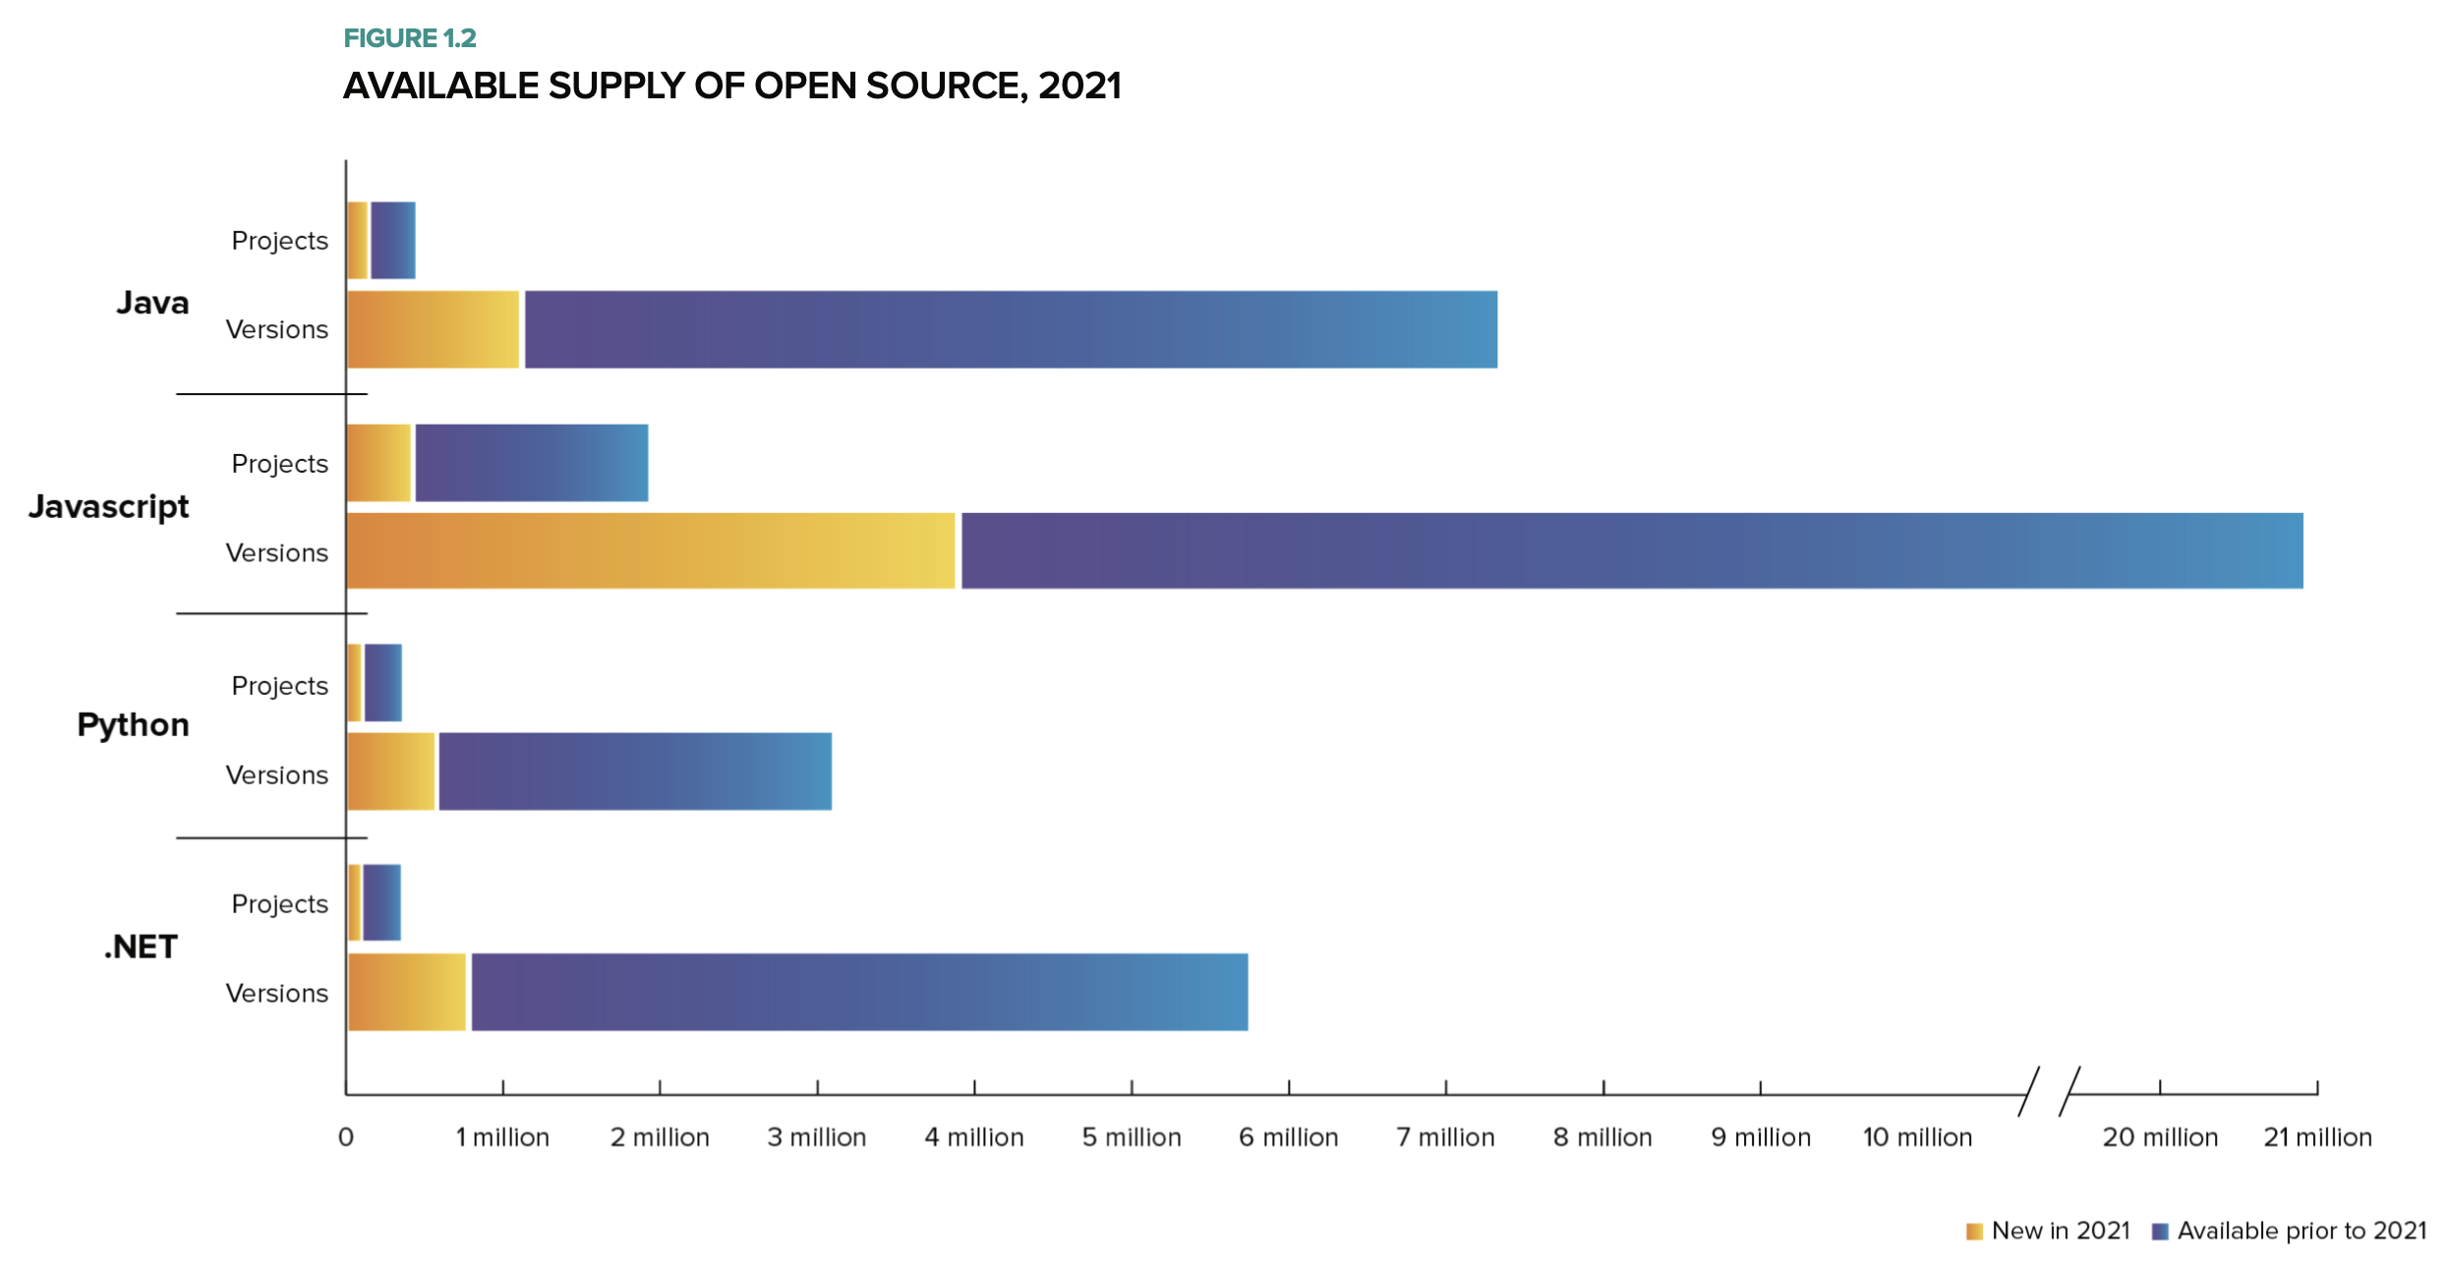
Global Supply & Demand for FOSS
Notes:
SUPPLY
As of July 31, 2021 there were 1,864,696 JavaScript packages available in the npm repository, up 16% from last year.
336,402 packages are available in the Python Package Index (PyPI), up 18% from last year.

Slide 9
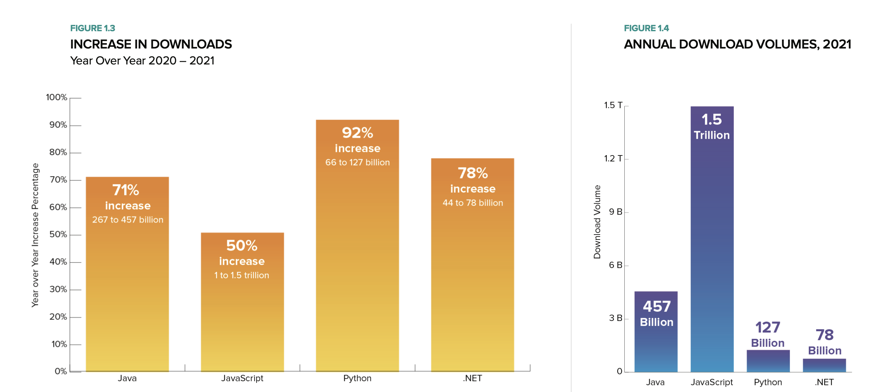
Global Supply & Demand for FOSS
Notes:
DEMAND
2021 - developers borrowed more than 2.2 trillion open source packages or components from third-party ecosystems for two simple reasons:
it makes life easier for software developers and
it accelerates the pace of innovation.
Through the first seven months of 2021, 267 billion Java components were downloaded from the Maven Central Repository.
In 2020, JavaScript developers requested more than one trillion packages from npmjs.
The volume for 2021 reached 1.5 trillion, a 50% YoY increase.
DEMAND for Innovation -> DEMAND for FOSS -> fuels Rapid Innovation (FOSS freely copied and modified) -> SUPPLY new versions and releases

Slide 10
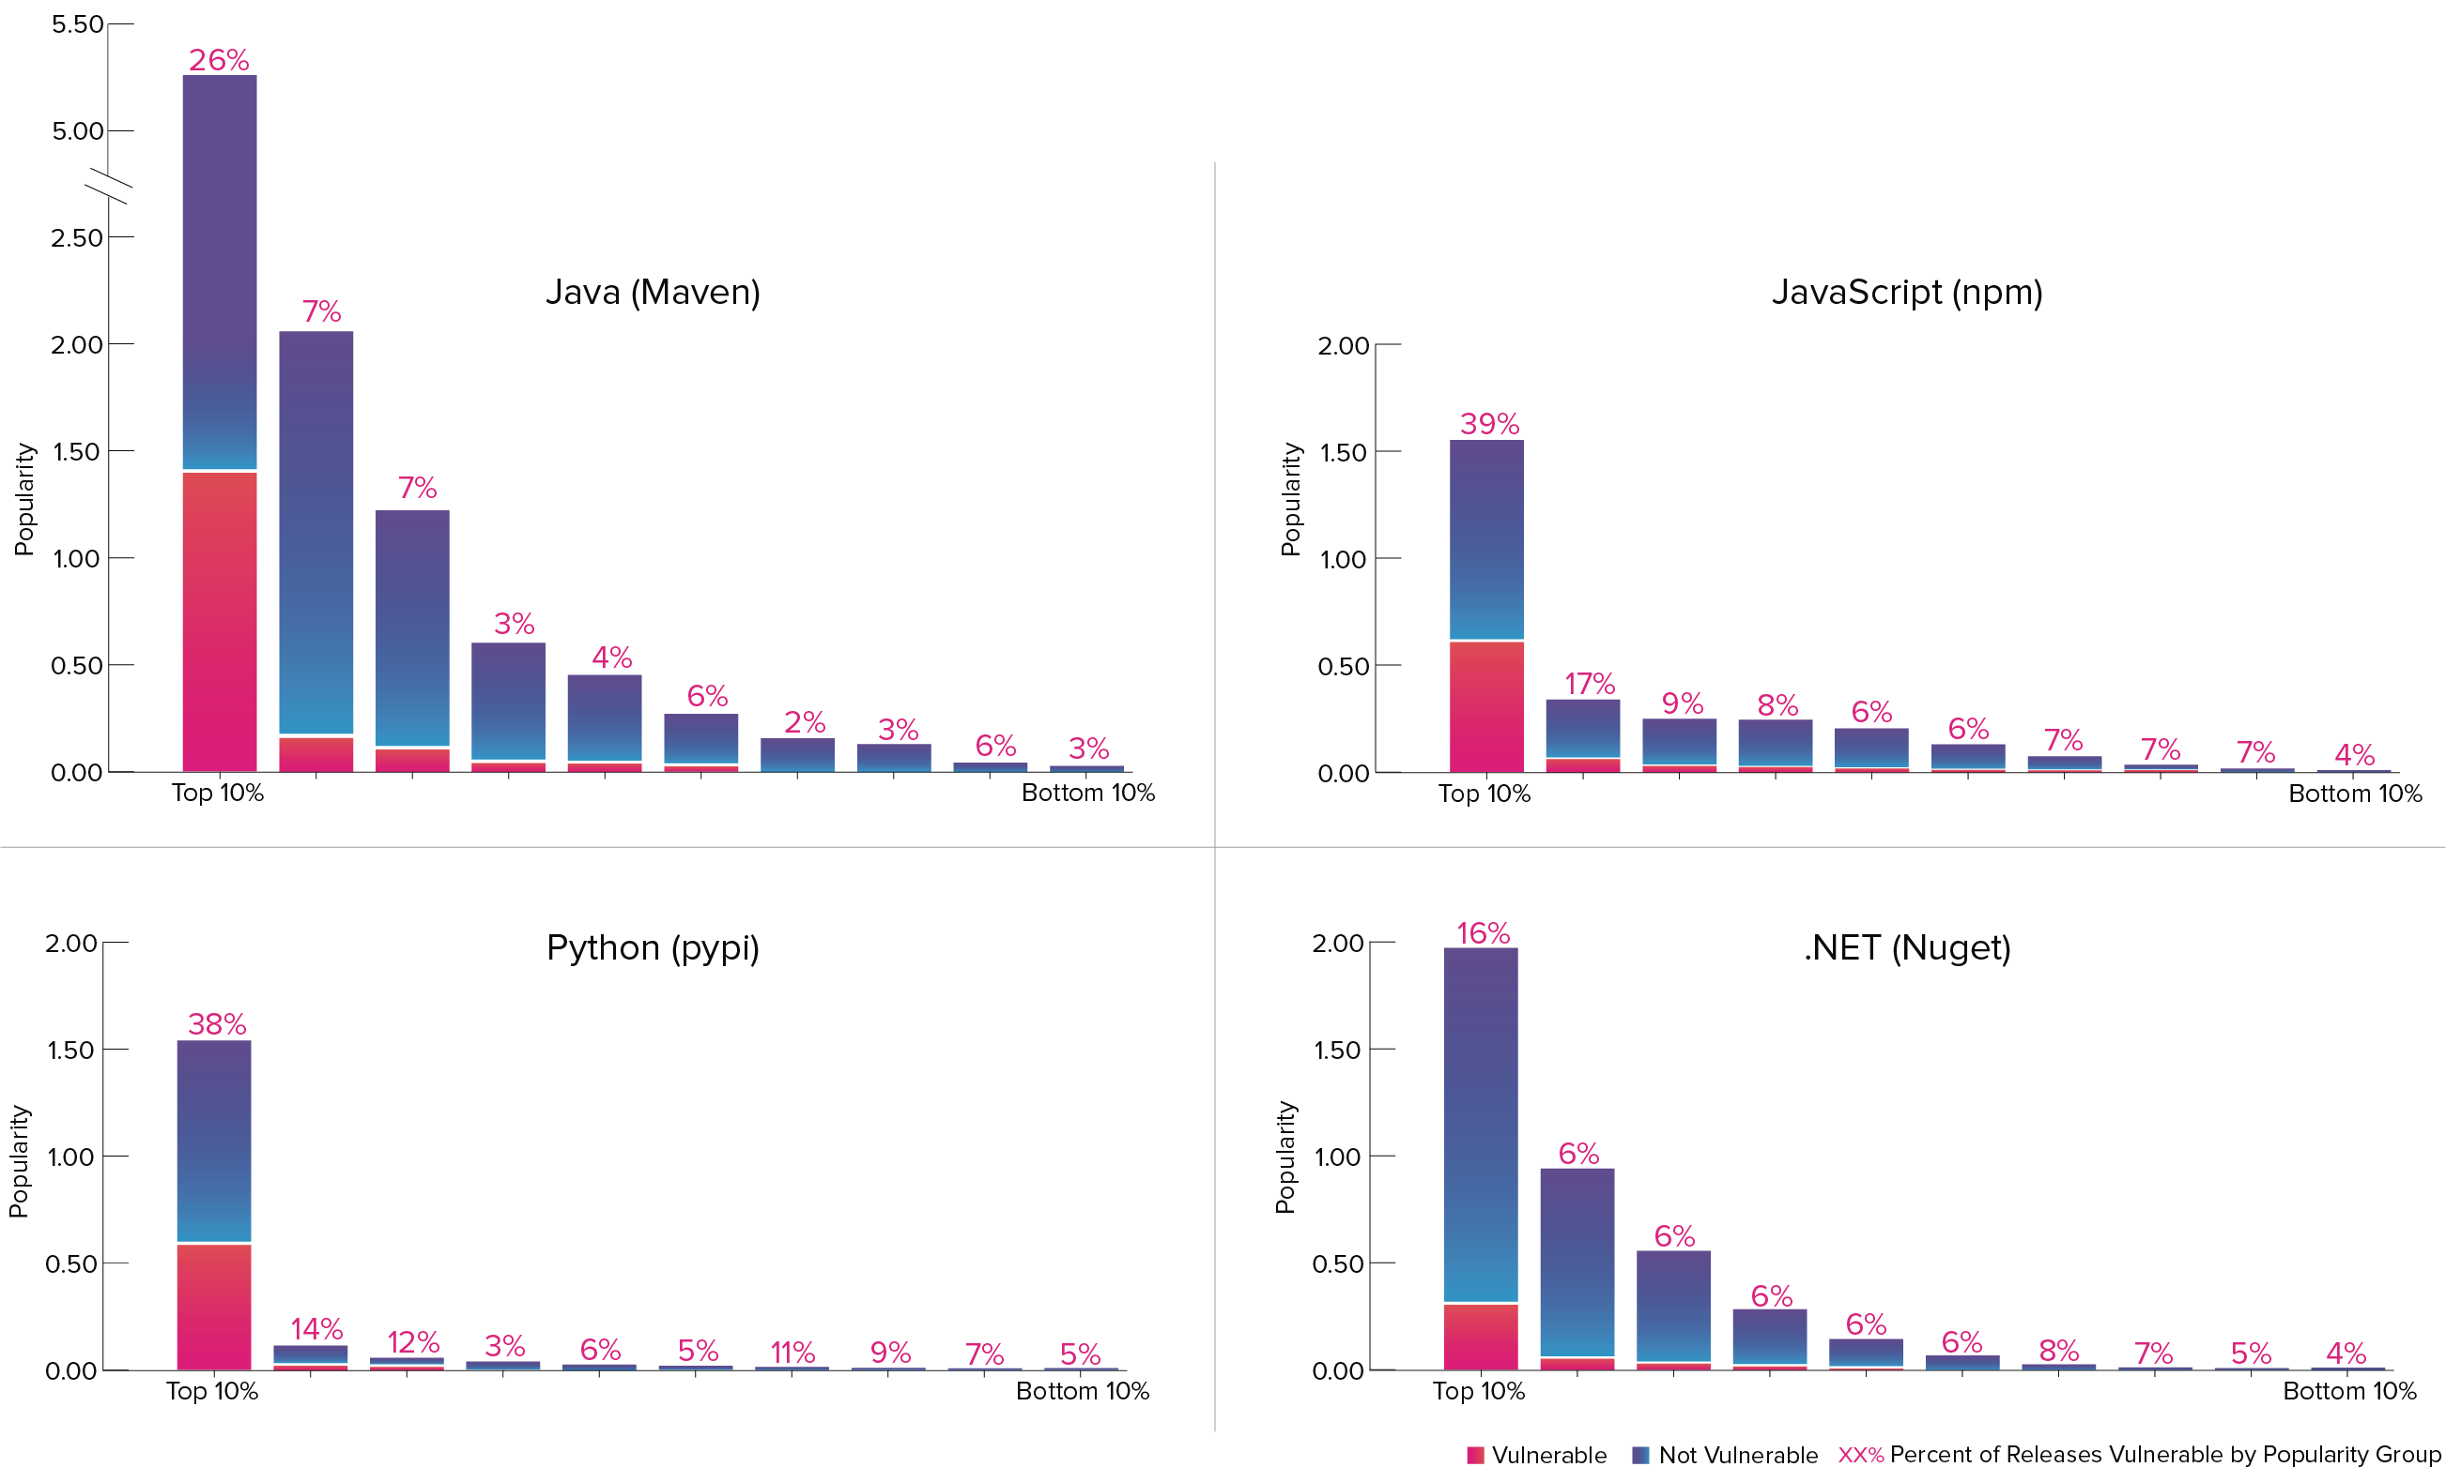
Open Source Security
Notes:
Java - As of July 31, 2021, 612,988 (8.4%) of all component versions housed in Maven Central contain at least one known security vulnerability.
356,808 (4.9%) had a CVSS of 9 or higher
488,826 (6.7%) had a CVSS of 7 or higher
598,364 (8.2%) had a CVSS of 5 or higher
Javascript (NPM) - As of July 31, 2021, 459,576 (2.2%) project versions housed in npm contain at least one known security vulnerability. Of the issues identified:
250,002 (1.2%) had a CVSS of 9 or higher
350,737 (1.6%) had a CVSS of 7 or higher
450,734 (2.1%) had a CVSS of 5 or higher

Slide 11
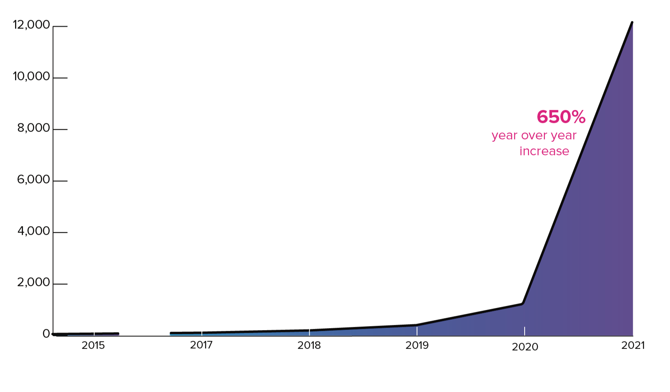
Next-Gen security “attacks”
Notes:
Legacy software supply chain “exploits," such as the now infamous 2017 Struts incident at Equifax, prey on publicly disclosed open source vulnerabilities that are left unpatched in the wild.
Next-generation software supply chain “attacks” are far more sinister, however, because bad actors are no longer waiting for public vulnerability disclosures to pursue an exploit.
Instead, they are taking the initiative and injecting new vulnerabilities into open source projects that feed the global supply chain, and then exploiting those vulnerabilities before they are discovered.
By shifting their attacks “upstream," bad actors can gain leverage and the crucial benefit of time that that enables malware to propagate throughout the supply chain, enabling far more scalable attacks on “downstream” users.
According to security researchers at the University of Bonn, SAP Labs France, and Fraunhofer FKIE,
“From an attacker’s point of view, [large scale, public internet-based] package repositories represent a reliable and scalable malware distribution channel.”

Slide 12

“By 2025, 45% of organizations worldwide will have experienced attacks on their software supply chains, a three-fold increase from 2021.”

Slide 13
Vulnerability Incidents

Slide 14
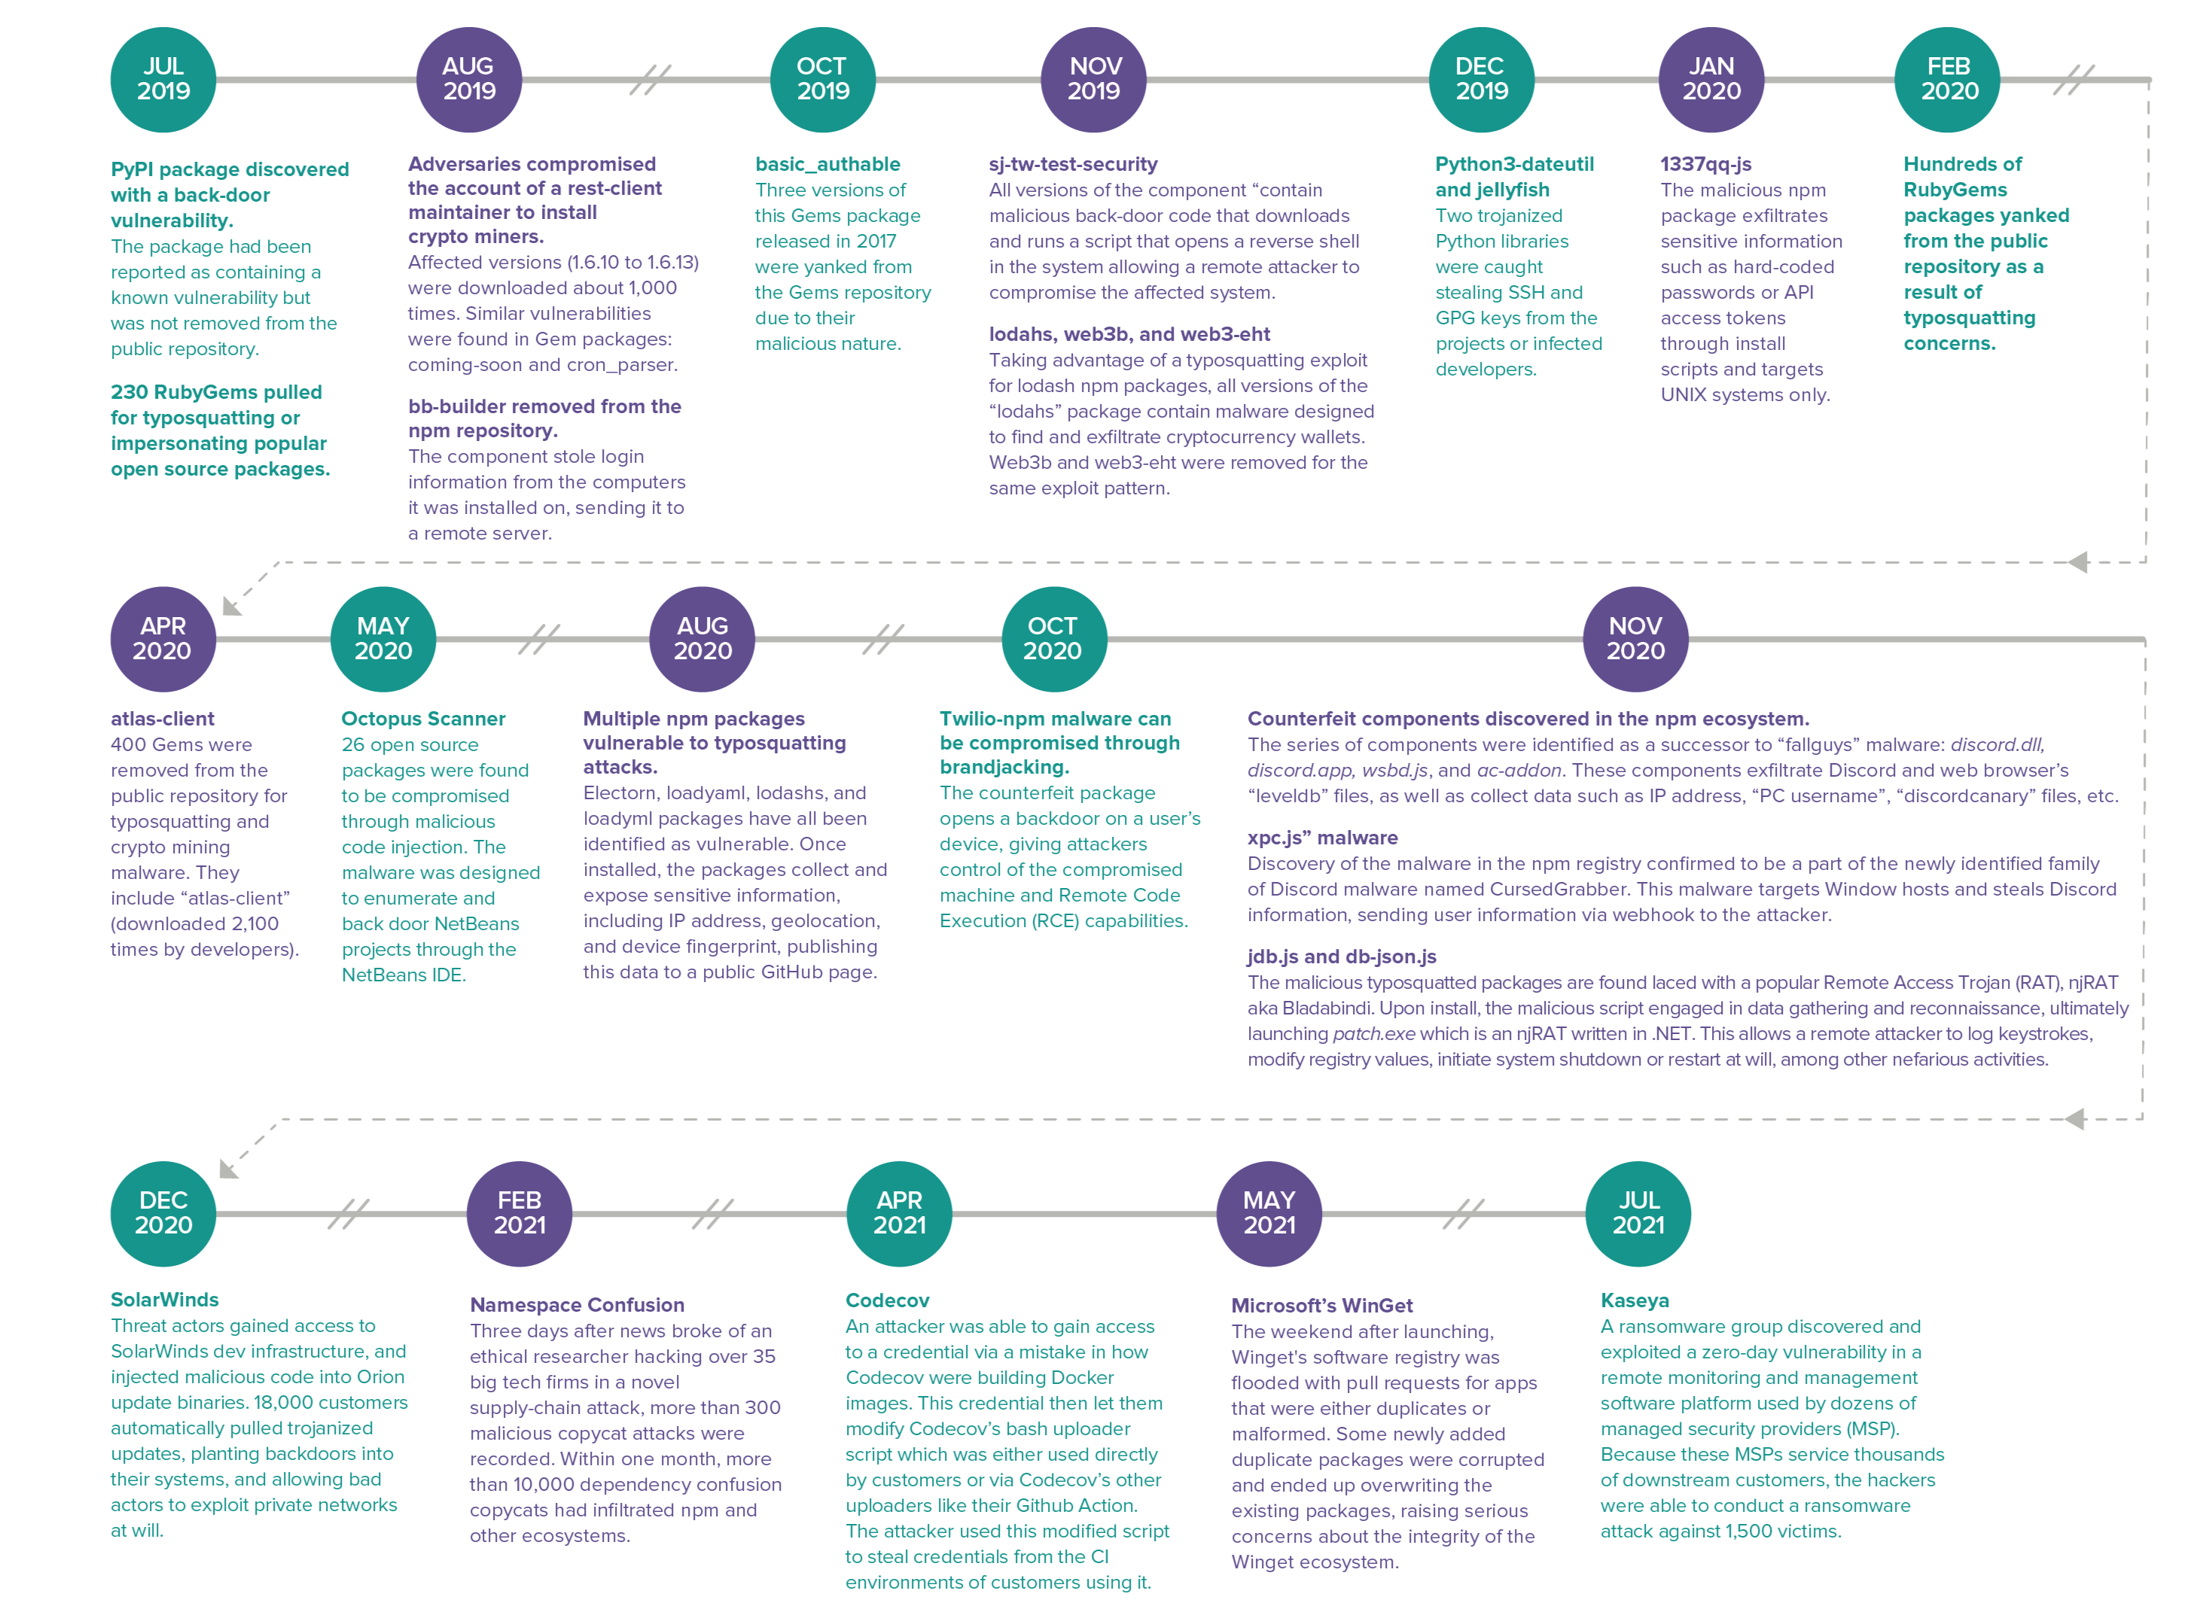
Next-Gen Software Supply Chain Incidents
Notes:
Dependency Confusion (Namespace Confusion)
The most common type of attack in 2021 has been Dependency Confusion (aka namespace confusion).
The novel, highly targeted, attack vector allows unwanted or malicious code to be introduced downstream automatically, without relying on typosquatting or brandjacking techniques.
The technique involves a bad actor determining the names of proprietary (inner source) packages utilized by a company’s production application.
Equipped with this information, the bad actor then publishes a malicious package using the exact same name, and a newer semantic version, to a public repository, like npmjs, that does not regulate namespace identity.
At this point, certain pipeline build tools will automatically fetch the newer, intentionally malicious version.
This attack vector relies on the long established convention in some programming languages to fetch the “LATEST” version of any package.
The name of this attack refers to the inability of your development environment to distinguish between a private, internally-created dependency in your software build, and a package by the same name available in a public software repository.
In other words, should an attacker register the name of your private, internally-used dependency on a public repository, such as npmjs, your software development tool may inadvertently pull in the attacker’s malicious dependency as opposed to your legitimate one.
Typosquatting
Typosquatting was the second most common technique over the past year.
This indirect attack vector preys on developers making otherwise innocent typos when searching for popular components.
For example, if a developer accidentally types “electorn” when their intention is to source “electron," they might accidentally install a malicious component of a similar name
(see electorn, September 2020 - Once installed, the packages discovered by Sonatype, collect the user’s IP address, geolocation data, along with their device’s fingerprinting information, and publishes this data to a public GitHub page.).
Malicious Source Code Injections
Malicious Source Code Injections are another type of attack that have been less prevalent in the past year compared to previous years.
Such attacks involve injecting malicious source code directly into an open source project’s repository, and have been conducted in various ways, including:
- stealing credentials from a project maintainer (see rest-client, 8/19)
- releasing new versions of a project to a public repository (see bootstrap-sass, 4/19)
- contributing pull requests to a project that includes malicious code (see event-stream, 11/18)
- tampering with open source developer tools that inject malicious code into downstream applications (see Octopus Scanner, 5/20).

Slide 15

SolarWinds
December 2020
Threat actors gained access to SolarWinds’ internal development tools to inject malicious code into SolarWinds’ Orion update binaries.
Roughly, 18,000 customers automatically pulled these malicious updates, exposing large companies and government entities.
Enabled bad actors to explore and exploit their networks at will over the course of many months.
Notes:
By attacking the SolarWinds software supply chain and mingling their malicious code with the legitimate, trusted code that was delivered to their clients,
attackers were able to plant backdoors on the systems of tens of thousands of SolarWinds’ customers.
Microsoft president Brad Smith said in a February congressional hearing that more than 80% of the victims targeted were nongovernment organizations.
US agencies: Pentagon, Department of Homeland Security, State Department, Department of Energy, National Nuclear Security Administration, Treasury.
Private companies: Microsoft, Cisco, Intel, and Deloitte, California Department of State Hospitals, and Kent State University.

Slide 16
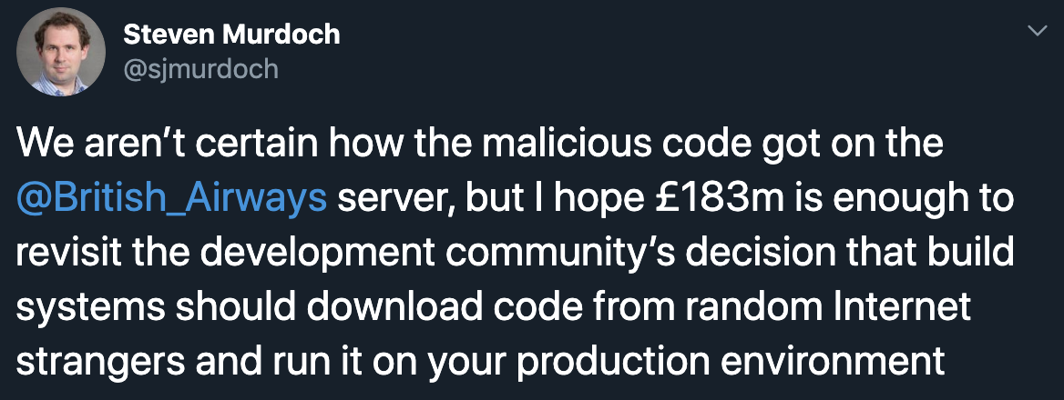
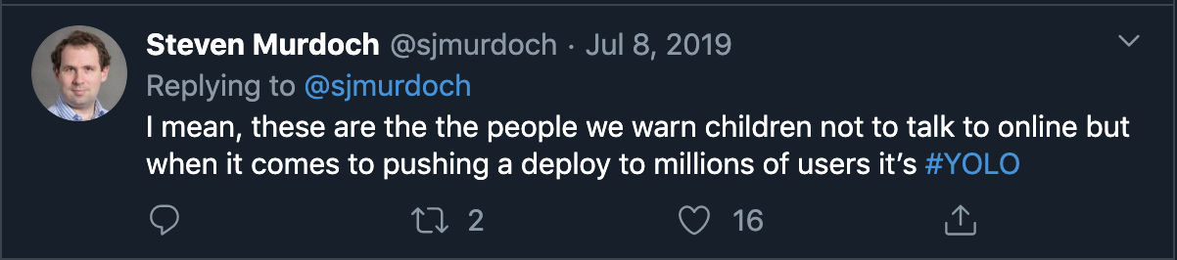
British Airways fined $237M
2019
Notes:
These incidents have consequences that go beyond the technical.
Javascript vulnerability on website diverted payment details to separate website (baways.com).
Infringements of the General Data Protection Regulation (GDPR)

Slide 17
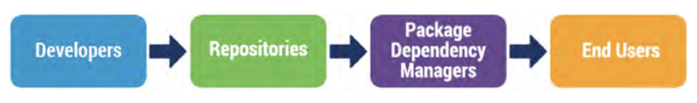
So, what’s can be done?
Notes:
Keep in mind, the image of a supply chain…

Slide 18
Developer Practices
Use 2FA/MFA for developer and other important accounts.
Require change control tracking throughout SDLC.
Use unique version identifier for each release.
Cryptographically sign or present verifiable proof of a project’s integrity.
Integrate testing into SDLC to check common bugs, unexpected behavior, and malicious changes.
Leverage tools to track, analyze, and manage dependencies.
Document project dependencies in a way that is readily consumable by downstream users.
Notes:
Use unique version identifier for each release, so downstream users can track new releases and establish controls and verification mechanisms around them.
- CNCF: Notary and TUF (The Update Framework)

Slide 19
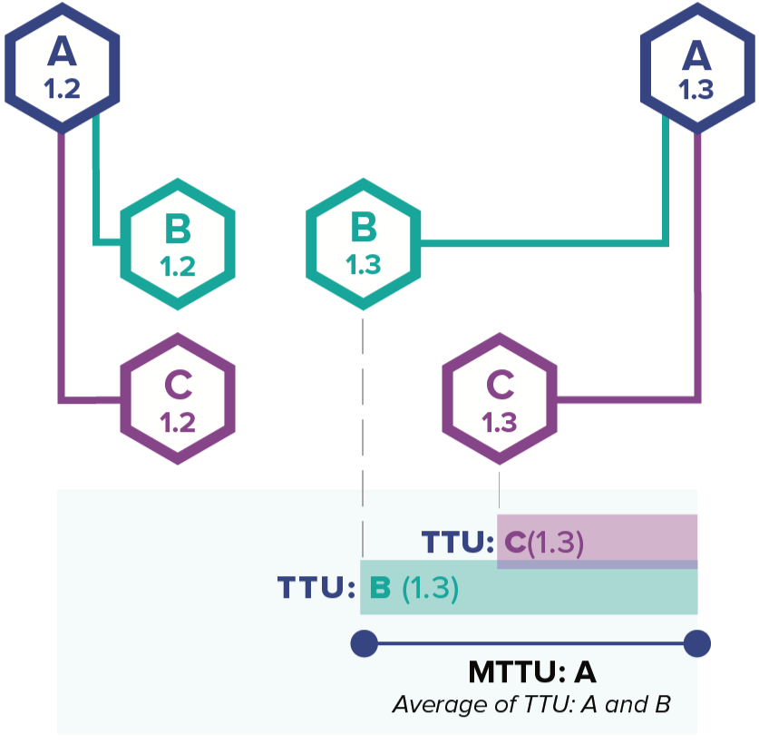
Project Development Practices
Mean Time to Update (MTTU)
Understand and minimize project MTTU metrics.
MTTU is the average time required for a project to respond to new versions of its dependencies.
Adopt defined criteria for selecting open source projects.
Select projects that have low MTTU.
Adopt and evaluate other metrics.
Notes:
MTTU, a measure of a project’s dependency update velocity, is strongly associated with improved project security.
MTTU also provides a measure of project quality that is based on how quickly the project moves to update dependencies. By this measure, quality has been increasing over the years.

Slide 20
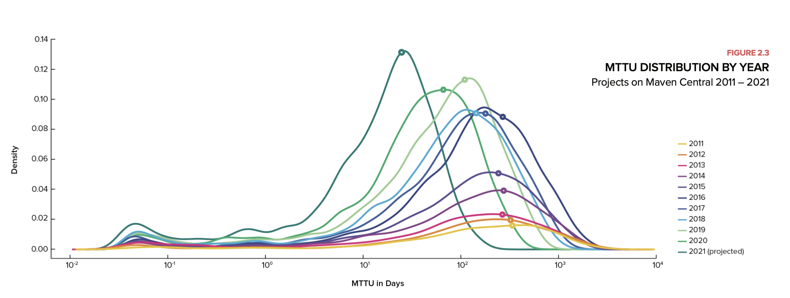
Project Development Practices
Mean Time to Update (MTTU)
Notes:
There has been a clear trend toward faster MTTUs by the larger community:
- 2011 average MTTU = 371 days - 2014 average MTTU = 302 days - 2018 average MTTU = 158 days - 2021 average MTTU (as of Aug 1) = 28 days

Slide 21
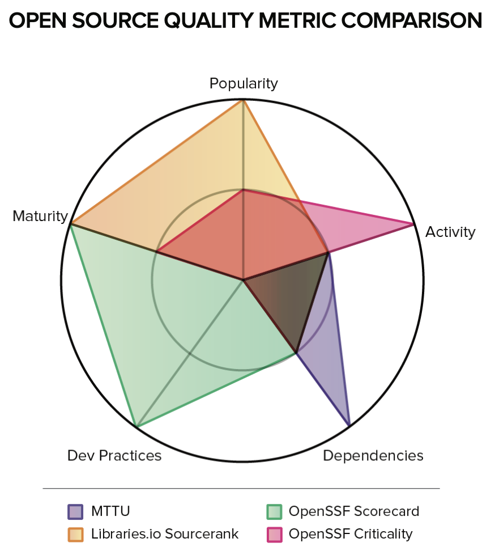
Project Development Practices
Other metrics
Libraries.io Sourcerank
Focusing on project documentation, maturity, and community.
OpenSSF Criticality Score
Measures a project’s community, usage, and activity.
OpenSSF Scorecard
Monitoring development practices, tooling use, and other project quality and maturity attributes.
Notes:
Popularity: stars, subscribers, usage
Activity: commit frequencies, release counts, MTTU
Dependencies: MTTU, outdated dependencies, automated dependency update tools.
Dev Practices: code reviews, CI pipelines, SCA and Security Testing tooling.
Maturity: semantic versioning, documentation, package/distribution handling, resolution time of issues, responsiveness of contributors, project creation date

Slide 22
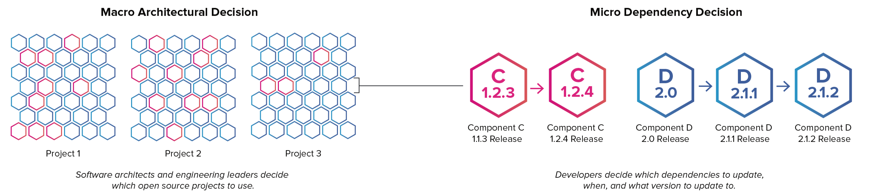
Dependency Management
Micro vs Macro Dependency Management
Notes:
There are three reasons why dependency management is rapidly becoming an increasingly important practice for software engineering teams:
1. The enormous volume of opensource dependencies present in production applications.
2. The incredible velocity at which new versions of dependencies are being released.
3. The fact that open source dependencies age like milk, and not like wine.
The average modern application contains 128 open source dependencies, and the average open source project releases 10 times per year.
Developers must constantly decide when (and when no to) update 3rd party dependencies.
But, ask most developers about dependency management, and they’ll tell you the same thing:
”keep open source libraries fresh and optimally up to date is a good idea that requires terribly mundane work.”
In other words, dependency management is seen as a thankless maintenance task that’s easy to get wrong, hard to get right, and generally detracts from time spent innovating.
Developers know that it’s important, but they frequently don’t have the time or patience to make it a priority and lack the tooling to do it optimally.
It’s no wonder that many developers describe this situation as “dependency hell.”

Slide 23
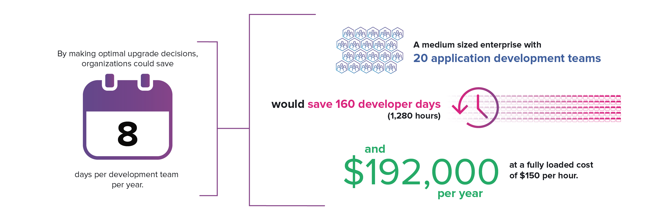
Dependency Management
Time saved with Intelligent Automation
Notes:
There is much room for improvement with respect to dependency management practices.
To optimize dependency management at scale, engineering leaders should embrace intelligent automation.
Engineering leaders should also embrace tools to guide macro decisions made with respect to initial technology selection.

Slide 24
Vulnerability Databases
Common Vulnerabilities and Exposures (CVE) & the National Vulnerability Database (NVD) programs
Missing or rejected vulnerabilities, leading to incomplete coverage in the NVD.
Severely delayed assignment of vulnerability identifiers, creating risks for downstream parties who remain unaware and likely unprotected from the issue.
Poorly contextualized descriptions of vulnerabilities, increasing the difficulty of mitigation and vulnerability management.
Overinflated and/or underplayed vulnerability scores, leading to misallocated resources and in some cases vulnerability “fatigue.”
Difficulty in revoking assigned vulnerabilities when they are found to be invalid, creating confusion and lack of trust in overall program.
Notes:
The NVD is considered so important that in 2018 it was exempted from the U.S. government shutdown.
Over 6,000 vulnerabilities went unassigned by MITRE’s CVE project in 2015.

Slide 25
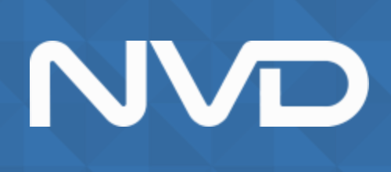
Vulnerability Databases
Social Issues with CVE and NVD
Abuse by developers who claim inflated numbers of vulnerabilities in order to pad resumes, creating “false positives.”
Abuse by engineers in organizations who see CVE assignments as a way to circumvent difficult management procedures preventing them from doing normal software upgrades.
Discomfort with the CVE program because it is managed by a US federal agency.

Slide 26
Government and Industry Efforts

Slide 27


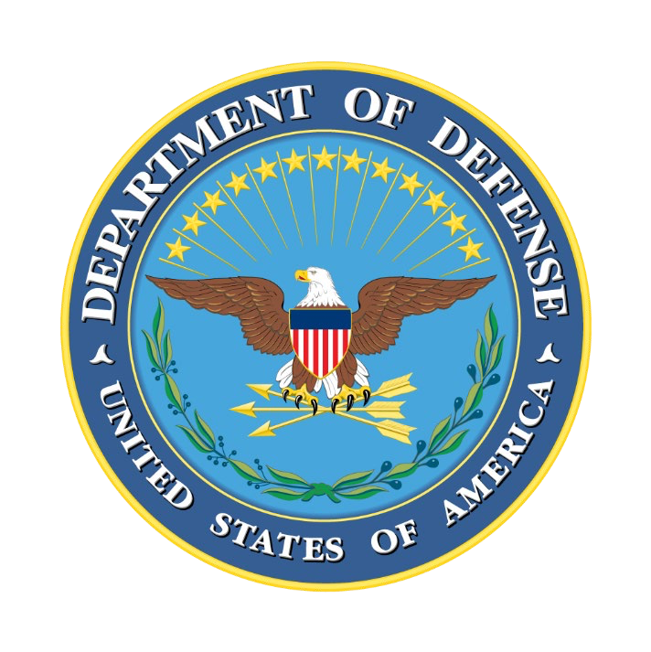
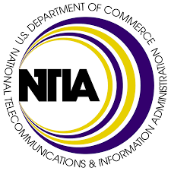
United States
Government Agencies and Standards
CISA and NIST releases paper “Defending Against Software Supply Chain Attacks”, formalizing software supply chain standards.
President Biden issues two Executive Orders for securing all supply chains and nation’s cybersecurity posture.
NTIA publishes a minimum definition of a ”Software Bill of Materials”.
U.S. Department of Defense releases “Zero Trust Reference Architecture”.
Notes:
February 2021
President Biden issues Execute Order for securing all supply chains. The order called upon the Secretaries of Commerce and Homeland Security to coordinate with heads of appropriate agencies to report on the security and integrity of critical information and communications technology software supply chains.
CIO for the Department of Defense (DoD CIO) rolled out a new reference architecture called Department of Defense (DOD), Zero Trust Reference Architecture (ZTA). Within the ZTA the DoD CIO outlined various Zero Trust Pillars and Capabilities including a section centered on protecting applications and software supply chains.
April 2021
CISA and NIST releases paper “Defending Against Software Supply Chain Attacks”, formalizing software supply chain standards.
Suggestions include:
Developing a written program to address software supply chain risk.
Inventorying organizational reliance on external software and code across all operational departments.
Assessing risk from these vendors and adopting appropriate contractual and other safeguards.
Coordinating efforts across management, IT, personnel, compliance, product development and operational departments.
Monitoring the threats and vulnerabilities to the software supply chain, including through technical measures and threat analysis, on an ongoing basis.
June, July 2021
NIST releases definition of “critical software” and publishes guidance for outlining security measures for critical software use and minimum standards for vendors’ testing of their software source code.
National Telecommunications and Information Administration (NTIA) releases a minimum definition of an SBOM.
SBOMs are effectively a nested inventory, a list of ingredients that make up software components, and provides those who produce, purchase, and operate software with information that enhances their understanding of the supply chain.
SBOMs are a formal, machine-readable inventory of software components and dependencies.
SBOMs contain information about those components, and their hierarchical relationships.
SBOMs may include open source or proprietary software and can be widely available or access-restricted.
3 Broad, interrelated areas:
Data Fields: Documenting baseline information about each component that should be tracked.
Automation Support: Allowing for scaling across the software ecosystem through automatic generation and machine-readability.
Practices and Processes: Defining the operations of SBOM requests, generation, and use.
House’s Homeland Security Committee introduces bipartisan bills focusing strictly on cybersecurity, including a “Pipeline Security Act” and “Cybersecurity Vulnerability Remediation Act”.
Senate Homeland Security and Governmental Affairs Committee introduces “The Supply Chain Security Training Act”.

Slide 28
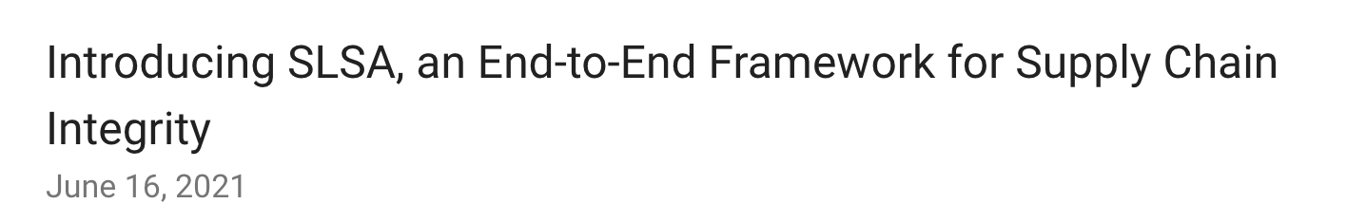
Google and OpenSSF SLSA
Supply chain Levels for Software Artifacts (SLSA, pronounced ”salsa”)
Our proposed solution is Supply chain Levels for Software Artifacts (SLSA, pronounced “salsa”), an end-to-end framework for ensuring the integrity of software artifacts throughout the software supply chain. It is inspired by Google’s internal “Binary Authorization for Borg” which has been in use for the past 8+ years and is mandatory for all of Google's production workloads.
The goal of SLSA is to improve the state of the industry, particularly open source, to defend against the most pressing integrity threats. With SLSA, consumers can make informed choices about the security posture of the software they consume.

Slide 29
Google and OpenSSF SLSA
Supply chain Levels for Software Artifacts (SLSA, pronounced ”salsa”)
Level | Description | Example
01 | Documentation of the build process | Unsigned provenance
02 | Tamper resistance of the build services | Hosted source/build, signed provenance
03 | Prevents extra resistance to specific threats | Security controls on hosts, non-falsifiable provenance
04 | Highest levels of confidence and trust | Two-party review + hermetic builds
Notes:
01
The build process must be fully scripted/automated and generate provenance. Provenance is metadata about how an artifact was built, including the build process, top-level source, and dependencies. Knowing the provenance allows software consumers to make risk-based security decisions. Provenance at SLSA 1 does not protect against tampering, but it offers a basic level of code source identification and can aid in vulnerability management.
02
Requires using version control and a hosted build service that generates authenticated provenance. These additional requirements give the software consumer greater confidence in the origin of the software. At this level, the provenance prevents tampering to the extent that the build service is trusted. SLSA 2 also provides an easy upgrade path to SLSA 3.
03
The source and build platforms meet specific standards to guarantee the auditability of the source and the integrity of the provenance respectively. We envision an accreditation process whereby auditors certify that platforms meet the requirements, which consumers can then rely on. SLSA 3 provides much stronger protections against tampering than earlier levels by preventing specific classes of threats, such as cross-build contamination.
04
Requires two-person review of all changes and a hermetic, reproducible build process. Two-person review is an industry best practice for catching mistakes and deterring bad behavior. Hermetic builds guarantee that the provenance's list of dependencies is complete. Reproducible builds, though not strictly required, provide many auditability and reliability benefits. Overall, SLSA 4 gives the consumer a high degree of confidence that the software has not been tampered with.

Slide 30
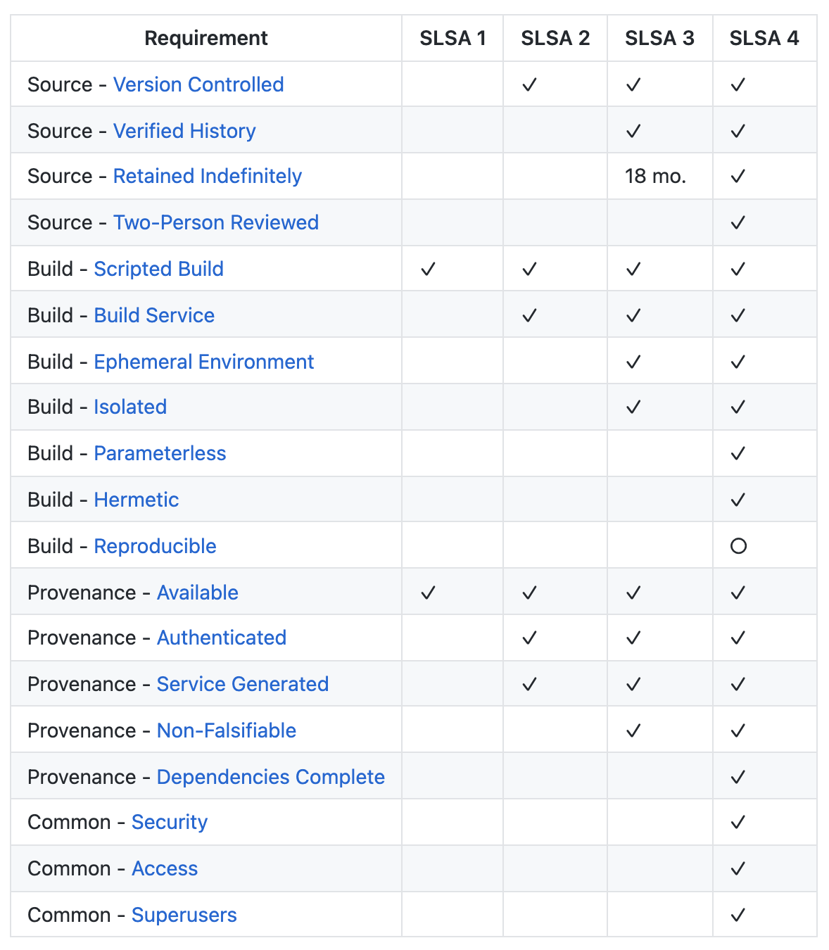













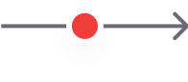
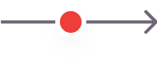
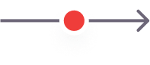
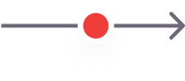

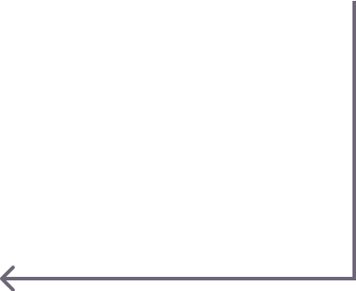

Google and OpenSSF SLSA
Supply chain Levels for Software Artifacts (SLSA, pronounced ”salsa”)
Source Integrity
Build Integrity
Compromise source control (B)
Compromise Build Platform (D)
Compromise Package Repository (G)
Submit bad code (A)
Modify Code (C)
Bypass CI/CD (F)
Use bad package (H)
Source
Build
Package
Use
Developer
SCM
CI/CD
Distribution
Use bad dependency (E)
Artifact Process Platform
Dependency
Notes:
01
The build process must be fully scripted/automated and generate provenance. Provenance is metadata about how an artifact was built, including the build process, top-level source, and dependencies. Knowing the provenance allows software consumers to make risk-based security decisions. Provenance at SLSA 1 does not protect against tampering, but it offers a basic level of code source identification and can aid in vulnerability management.
02
Requires using version control and a hosted build service that generates authenticated provenance. These additional requirements give the software consumer greater confidence in the origin of the software. At this level, the provenance prevents tampering to the extent that the build service is trusted. SLSA 2 also provides an easy upgrade path to SLSA 3.
03
The source and build platforms meet specific standards to guarantee the auditability of the source and the integrity of the provenance respectively. We envision an accreditation process whereby auditors certify that platforms meet the requirements, which consumers can then rely on. SLSA 3 provides much stronger protections against tampering than earlier levels by preventing specific classes of threats, such as cross-build contamination.
04
Requires two-person review of all changes and a hermetic, reproducible build process. Two-person review is an industry best practice for catching mistakes and deterring bad behavior. Hermetic builds guarantee that the provenance's list of dependencies is complete. Reproducible builds, though not strictly required, provide many auditability and reliability benefits. Overall, SLSA 4 gives the consumer a high degree of confidence that the software has not been tampered with.

Slide 31
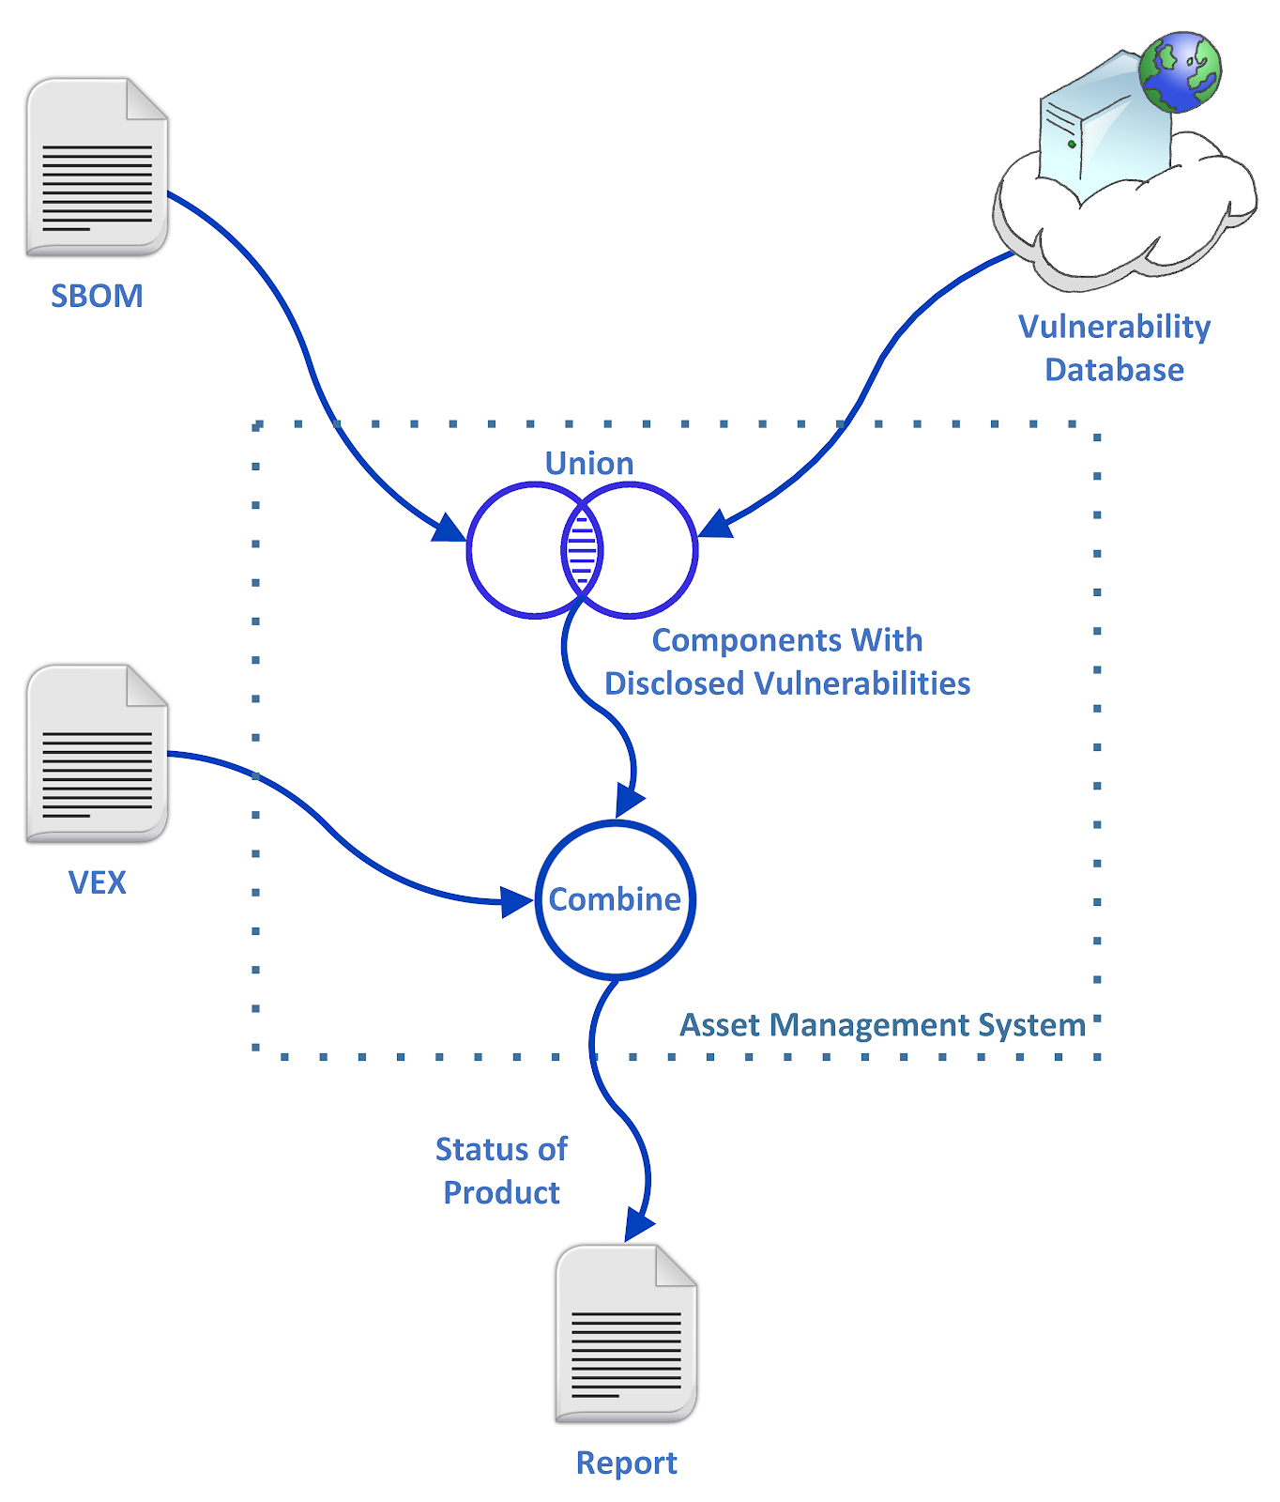
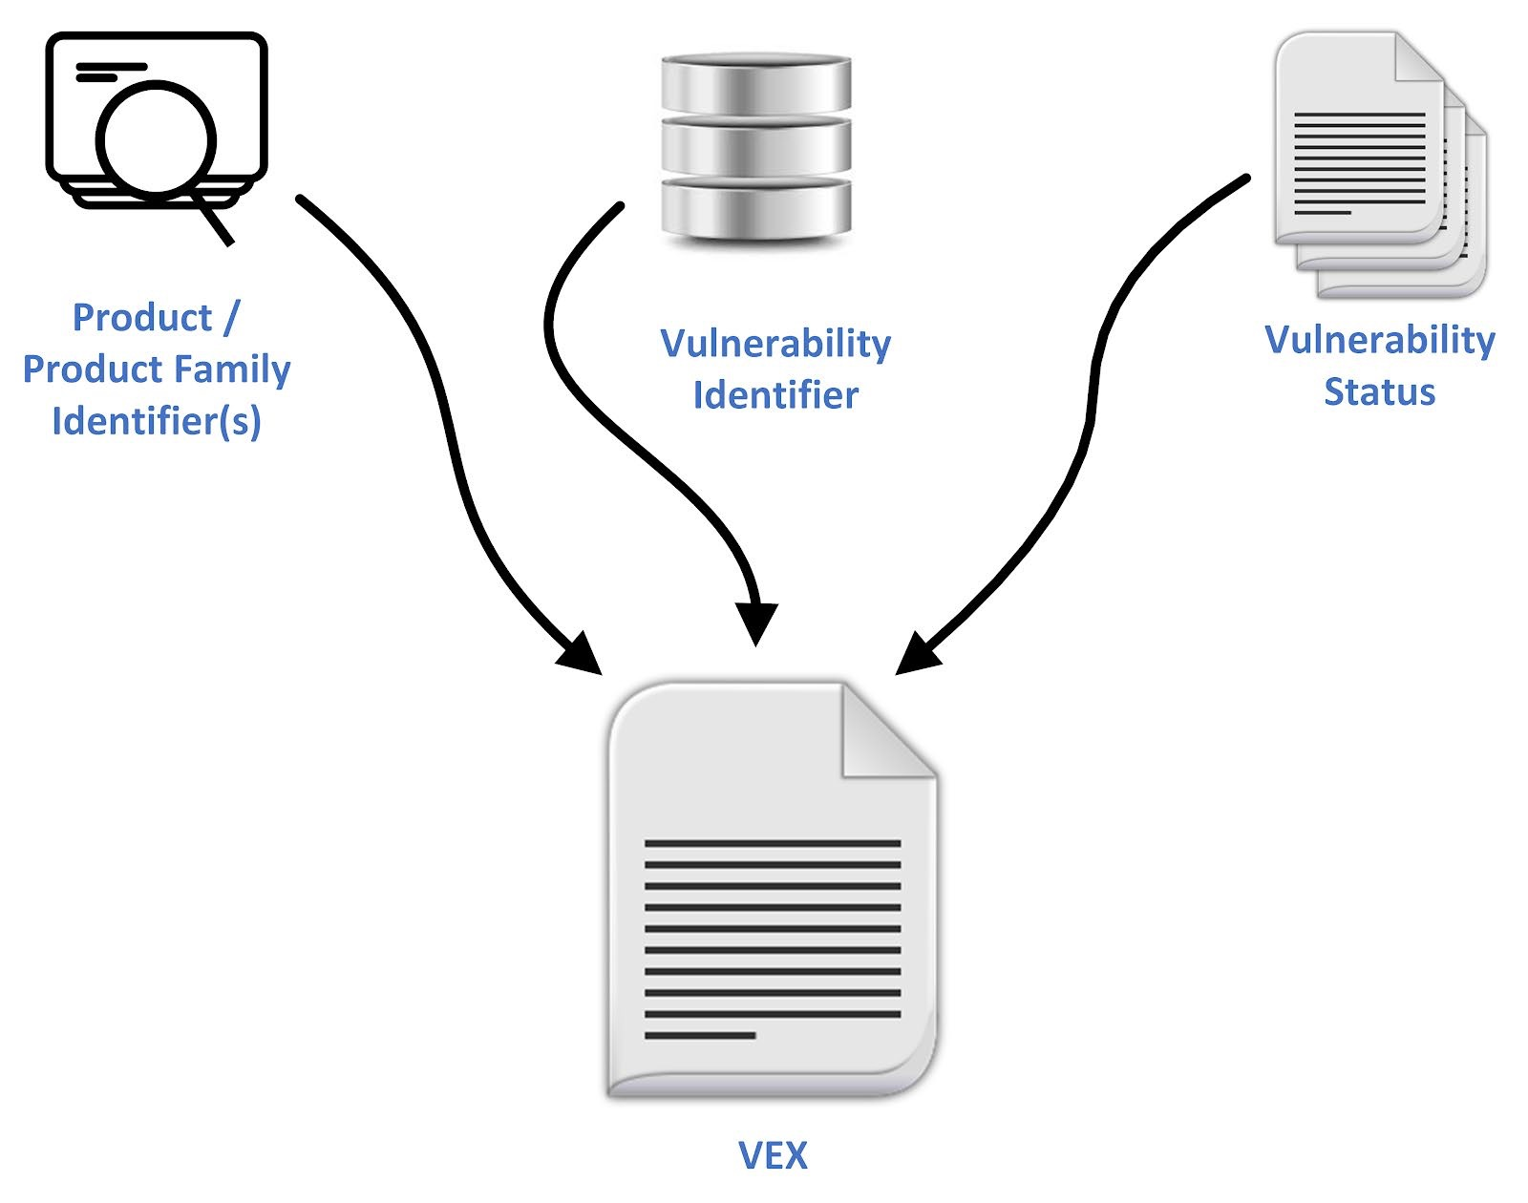
Vulnerability-Exploitability eXchange (VEX)
How do we understand the exploitability status of a particular vulnerability?
Notes:
The primary use cases for VEX are to provide users (e.g., operators, developers, and services providers) additional information on whether a product is impacted by a specific vulnerability in an included component and, if affected, whether there are actions recommended to remediate.
In many cases, a vulnerability in an upstream component will not be “exploitable” in the final product for various reasons (e.g., the affected code is not loaded by the compiler, or some inline protections exist elsewhere in the software).
This allows us to:
Determine the current state of the system.
Create actions based on better knowledge of the known state.
Better prioritization of those actions.
Better predictability of how those actions will affect the future state.
Repeat!
Four levels of True Positives:
Are you using the vulnerable package?
Can you reach the vulnerable code?
Is the vulnerable code Executed in a critical Environment?
Is the vulnerable code Exploitable?

Slide 32
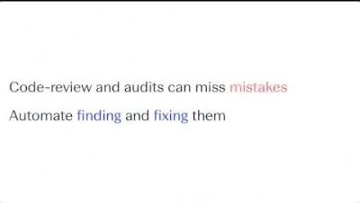
Automated Intelligent Remediation

Slide 33
Conclusion

Slide 34
Conclusion
Health and Security of FOSS Supply Chain
Global Demand for Open Source
Software Supply Chain
Challenges
Ongoing Efforts
The growing demand for innovation accelerating open source consumption.
Ensuring the health and security of FOSS Supply Chain is critical to the future of nearly all industries in the modern economy.
Increasing number of components
Transitive dependencies
High manual efforts –
“dependency hell”
Obtuse vulnerability assessments
Government and Industry Standards
OpenSSF and
The Linux Foundation
Automated and Intelligent tooling
Notes:
Software Supply Chain - Need to understand what components are being used, and how well they’re maintained.

Slide 35
References
Vulnerabilities in the Core: Preliminary Report and Census II of Open Source Software
2019 State of the Software Supply Chain
Open Source Software Supply Chain Security
OpenSSF Concise Guide for Evaluating Open Source Software 2022-09-01

